Slide 1
Spatial Proteomics
Prof. Jean Fan

Slide 2
Lesson Objectives
Learn about spatial proteomics
Analyze and visualize a new spatial proteomics dataset together

Slide 3
Why protein?

Slide 4
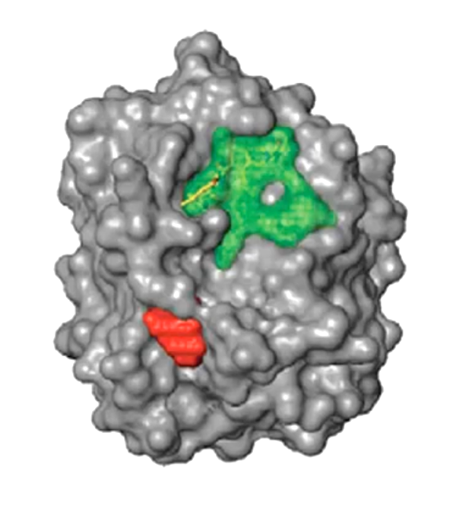
How can we detect proteins?
Protein
Epitope
(antigenic determinant)

Slide 5
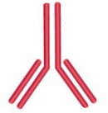
Protein epitopes can be identified with antibodies
(primary) Antibody

Slide 6
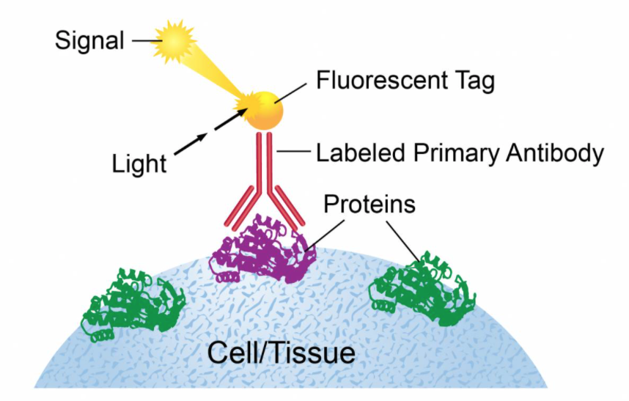
Ex. Immunofluorescence

Slide 7
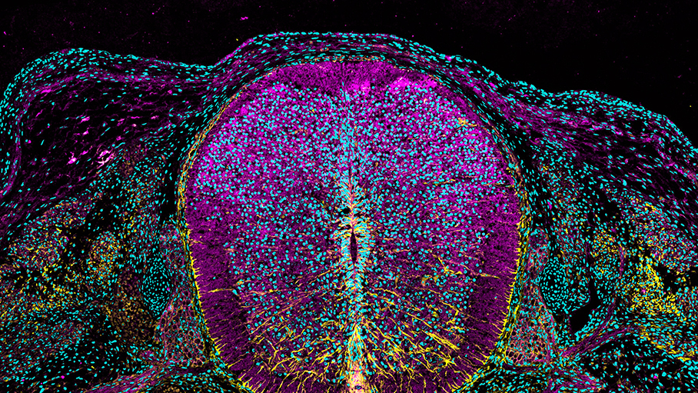


https://www.cell.com/pictureshow/immunofluorescence-ii
Vimentin (yellow)
N-cadherin (magenta)
Dapi (cyan)

Slide 8
What are antibodies? How are they made?

Slide 9
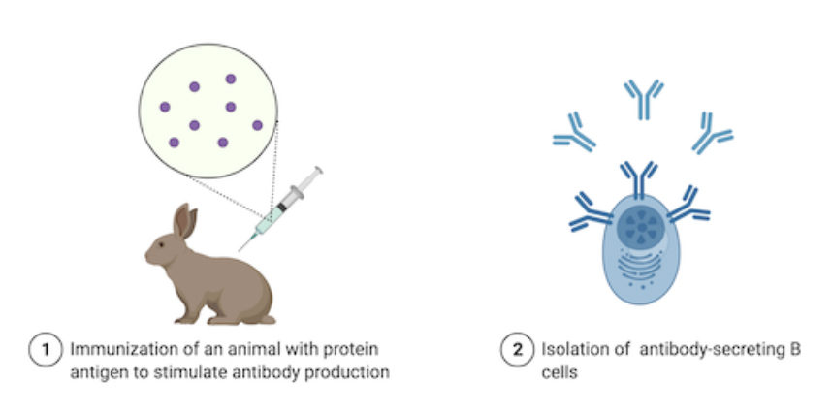
What are antibodies? How are they made?
Can stop here
but b-cells
are polyclonal
+ don’t live long
Source: https://blog.addgene.org/antibodies-101-monoclonal-antibodies

Slide 10
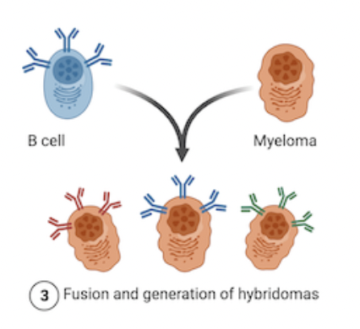
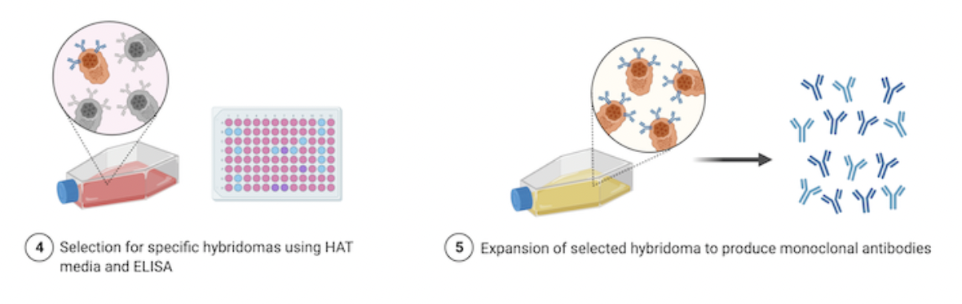

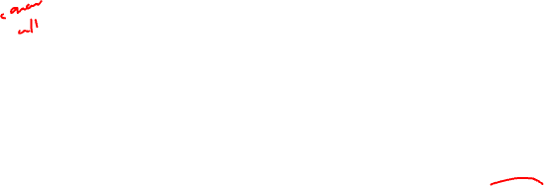
What are antibodies? How are they made?
1970s (Nobel Prize of 1984)
Source: https://blog.addgene.org/antibodies-101-monoclonal-antibodies

Slide 11
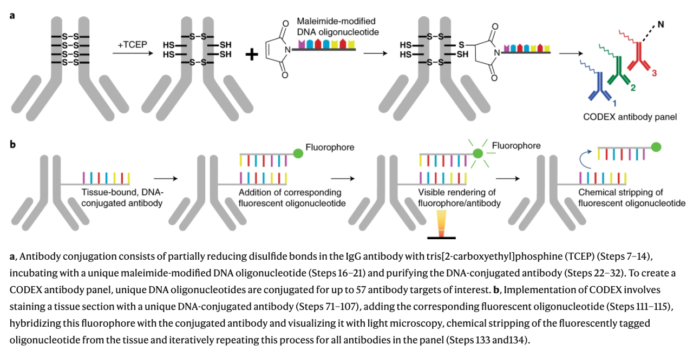
CODEX (CO-Detection by indEXing)
Dr. Gary Nolan at Stanford
Black, et al. Nat Protoc 2021

Slide 12

CODEX (CO-Detection by indEXing)
Dr. Gary Nolan at Stanford
Black, et al. Nat Protoc 2021

Slide 13
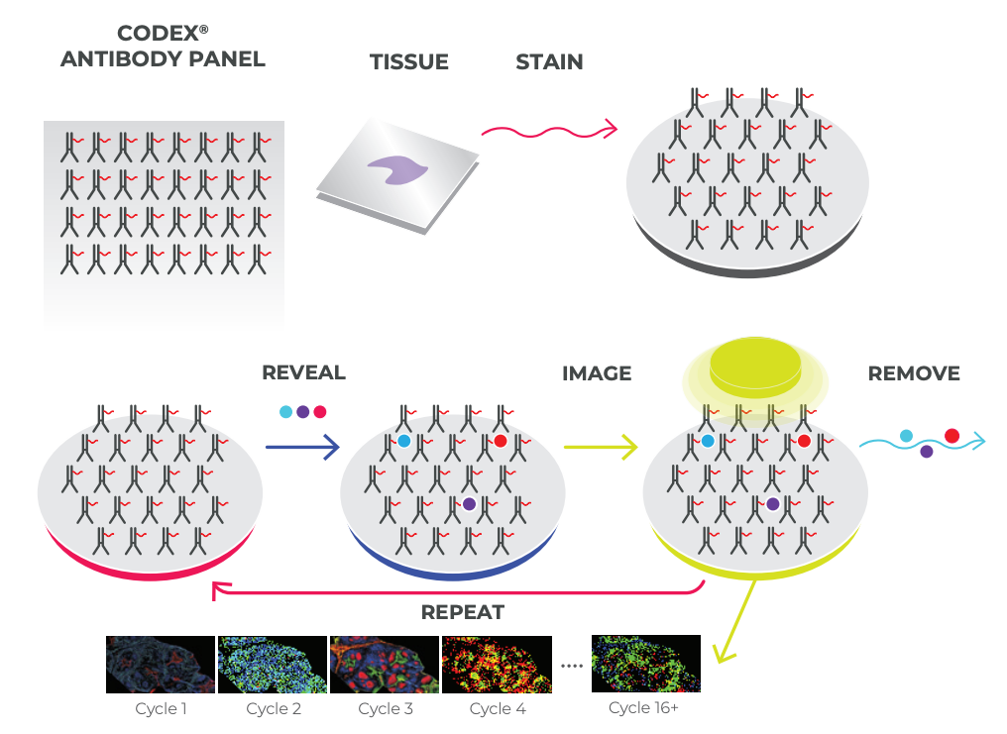
CODEX (CO-Detection by indEXing)
Akoya. Technical Note. Validation of CODEX Antibodies

Slide 14
CODEX (CO-Detection by indEXing)
~40 proteins
Akoya. Technical Note. Validation of CODEX Antibodies

Slide 15
Practice
We want to measure 18 proteins in a tissue
Using CODEX with 3 colors, we can measure 3 proteins in each imaging round
How many rounds of imaging do we need to image all 18 proteins?

Slide 16
Practice
Recall: multiplexed smFISH useds a multiplexing scheme to increase the number of different genes that can be measured
Why do we not using multiplexing for proteins?

Slide 17
What are some potential challenges for characterizing the proteome?

Slide 18
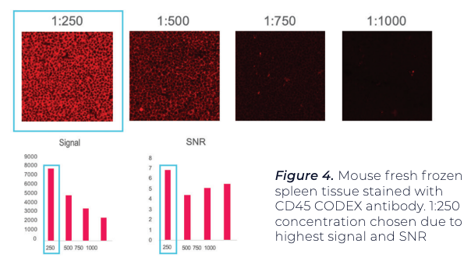
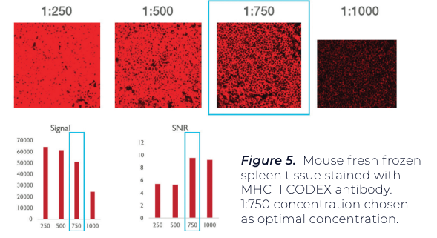
Antibody titration needed to minimize non-specific binding and improve signal to noise ratio
Using positive test tissue, maximize signal-to-noise ratio (SNR) and average signal.
A threshold is set for both signal and noise.
A binary map is used to confirm that pixels associated with signal and noise
Antibody A
Antibody B

Slide 19
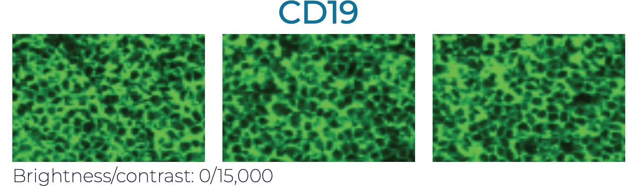
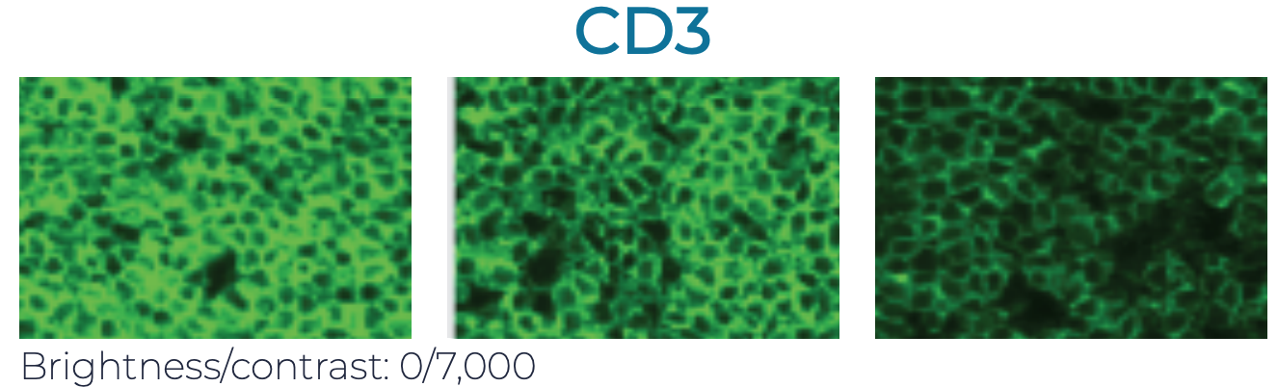
Antibodies may interfere with each other (steric hindrance)
Even if it works well by itself, it may not give the same performance when used in combination with others. Therefore need to test:
Individually
In the presence of a few other antibodies (positive and negative counterstains)
In the presence of many other antibodies
1
2
3

Slide 20
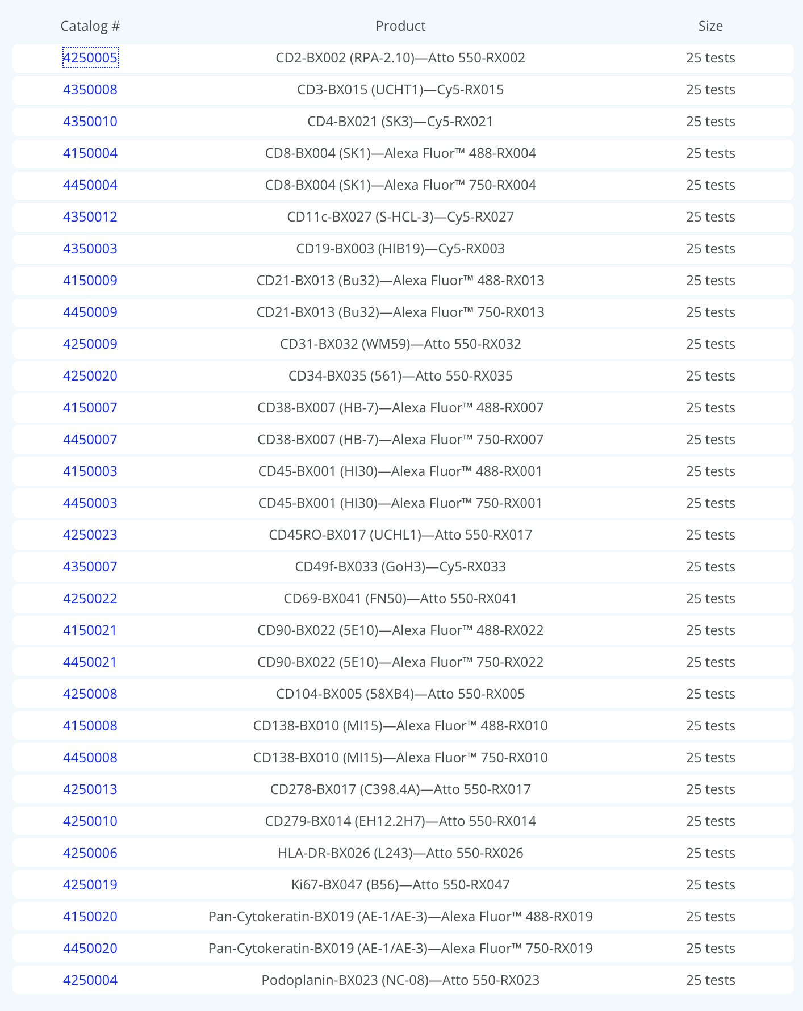
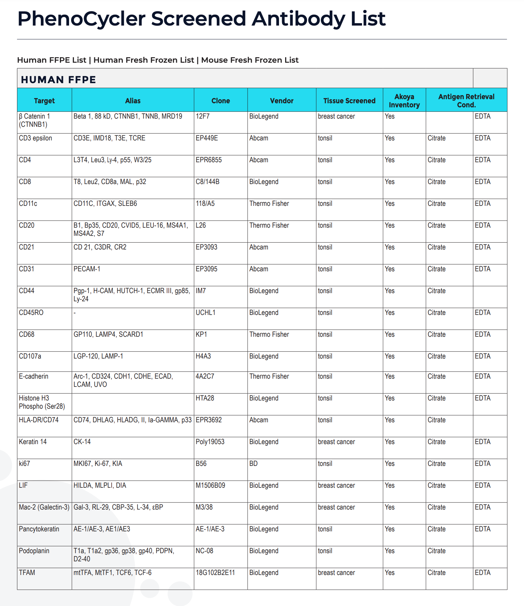
Antibodies for proteins of interest may not be available
~ 30 approved (work well together)
~ 300 screened (unclear if will work well together)
How many different proteins are in the proteome?
(on the order of)
Recall we have ~20k different RNAs
Notes:
80,000 to 400,000 proteins

Slide 21
Practice question
GeneA and GeneB are upregulated in microglia, Prof. Fan’s cell-type of interest
GeneA encodes for a secreted protein ProteinA
GeneB encodes for a nuclear protein ProteinB
Good antibodies are available for both proteins
Prof. Fan wants to stain for one of these proteins to identify microglia in the brain and study their spatial organization
Which protein should she stain for and why?

Slide 22
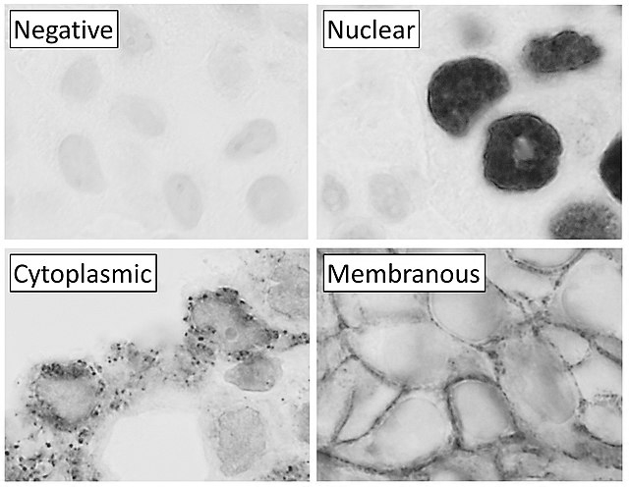

Slide 23
HW5 – analyze a CODEX dataset
Perform a full analysis (quality control, dimensionality reduction, kmeans clustering, differential expression analysis) on your data. Your goal is to figure out what tissue structure is represented in the CODEX data. Options include: (1) Artery/Vein, (2) White pulp, (3) Red pulp, (4) Capsule/Trabecula
You will need to visualize and interpret at least two cell-types. Create a data visualization and write a description to convince me that your interpretation is correct.
Your description should reference papers and content that allowed you to interpret your cell clusters as a particular cell-types. You must provide attribution to external resources referenced. Links are fine; formatted references are not required.
You must include the entire code you used to generate the figure so that it can be reproduced.

